Slide 1
Basics of programming

Slide 2
Basics of programming
Teacher: Petteri Mäkelä, Principal Lecturer, Lic. Tech.
2 ECTS

Slide 3
Tools
Express 2013 for Windows Desktop
http://www.visualstudio.com/en-us/products/visual-studio-express-vs.aspx

Slide 4
Course material
We will learn the basics of the programming by reading the following tutorials:
http://www.csharp-station.com/Tutorial.aspx
http://csharp.net-tutorials.com
In addition, we will make a lot of programming

Slide 5
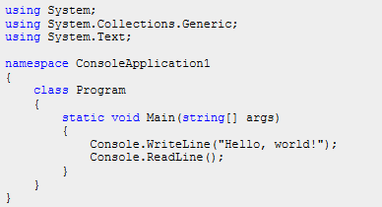
First program – Hello World!
Hello World program is explained on web site: http://csharp.net-tutorials.com/basics/hello-world/

Slide 6
Data types
All the variables used in a computer program have a data type.
The most important data types are:
bool: only two values, true and false
int: data type for integer numbers
string: is used for storing text, that is, a number of chars
char: is used for storing a single character
double: data type for decimal numbers. Avoid using the data type float.
http://csharp.net-tutorials.com/basics/data-types/

Slide 7
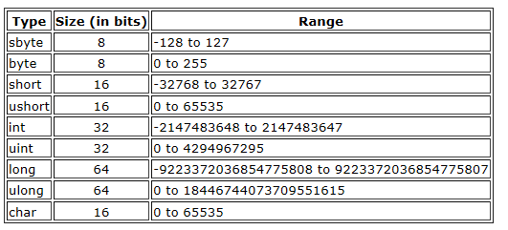
Integral data types
Integral types are whole numbers, either signed or unsigned, and the char type. The char type is a Unicode character, as defined by the Unicode Standard.
Integral types are well suited for those operations involving whole number calculations
Usually the size is defined in bytes (1 byte = 8 bits)

Slide 8
Integral data types
The range of the integral data type is obtained by calculating pow(2, size of variable)-1
For example ushort (unsigned short) has 16 bits. So the maximum value of a variable of the data type short is pow(2, 16)-1 = 65535
For signed integral data types one bit is used for sign.
The smallest possible number is -pow(2, 15) = -32768
The biggest number is pow(2,15)-1 = 32767.

Slide 9
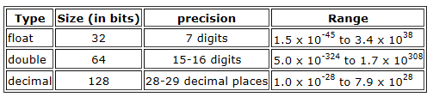
Floating point decimal types
A C# floating point type is either a float or double. They are used any time you need to represent a real number, as defined by IEEE 754.
Decimal types should be used when representing financial or money values (decimal data type is not handled in this course).
Floating point types are used when you need to perform operations requiring fractional representations. However, for financial calculations, the decimal type is the best choice because you can avoid rounding errors.
Mostly there is no reason to use the float data type. Use double instead, because it has much better precision (15-16 digits (numbers after decimal points))

Slide 10
Data types and variables

Slide 11
Variables
Variables are simply storage locations for data. You can place data into them and retrieve their contents as part of a expression. The interpretation of the data in a variable is controlled through data types.
Variable is declared like this:
<data type> <name>;
Example:
int counter;

Slide 12
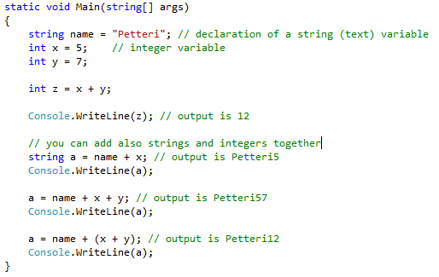
Variables - Example

Slide 13
Exercises
Make a program, which outputs the smallest and largest values of the integer datatypes
http://www.csharp-station.com/Tutorials/Lesson02.aspx

Slide 14
Comments
The program code may contain comments. Comments are usually used to document the code (to make it easier to understand)
Comments are not compiled
Examples of comments
/* This is a multiple line comment */
// this is a single line comment

Slide 15
Input and output in Console programs

Slide 16
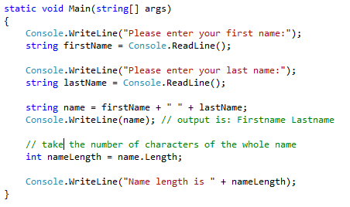
Reading the user input
The following program reads the users first name and last name and outputs the whole name and its length
Console.ReadLine() returns the user input as string

Slide 17
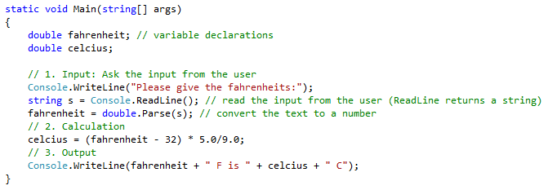
Reading the user input
The following program converts the Fahrenheit degrees to the Celcius degrees
Note that the user input has to be converted to double data type by using method double.Parse(string s)
In case of int data types the conversion would be int.Parse(string s)
Example: int number = int.Parse(s);

Slide 18
Converting the user input to a number
The following two statements
string s = Console.ReadLine(); fahrenheit = double.Parse(s);
Can be combined as a single statement
fahrenheit = double.Parse(Console.ReadLine());

Slide 19
Exercises
Make a program which calculates the fare of the taxi trip. Initial fare is $2.50 and $2.00 for each mile. The program asks the distance of the taxi trip and calculates the total cost.
Make a program, which calculates the volume of a cylinder. The radius and height of the cylinder are asked from the user
Make a program which asks the x and y coordinates of two points (A and B) from the user. The program calculates the distance between these two points A and B

Slide 20
Exercises (homework 26.9.2012)
Make a program which calculates the amount of sales tax (VAT, euros) and the total price of the product. The net price (price without taxes) and the sales tax percent are asked from the user
Make a program which makes conversion between American and European (SI system) volume units. The program asks first whether the user want to convert from cubic centimeters to cubic inches or vice versa. After that the program asks the input from the user and performs appropriate conversion. You get extra points if you utilize methods in your program.

Slide 21
Conditional Statements if-else

Slide 22
if - else
Study how if and else statements work
Read the chapter The if Statement from the page
http://www.csharp-station.com/Tutorials/Lesson03.aspx
Or
http://csharp.net-tutorials.com/basics/if-statement/

Slide 23
Operators
The most common operators:
Category (by precedence) | Operator(s) | Associativity
Unary | + - ! ~ ++x --x (T)x | left
Multiplicative | * / % | left
Additive | + - | left
Shift | << >> | left
Relational | < > <= >= is as | left
Equality | == != | right
Conditional AND | && | left
Conditional OR | || | left
Assignment | = *= /= %= += -= <<= >>= &= ^= |= => | right

Slide 24
if - else
One of the single most important statements in every programming language is the if statement.
Being able to set up conditional blocks of code is a fundamental principal of writing software.
The if statement needs a boolean result, that is, true or false

Slide 25
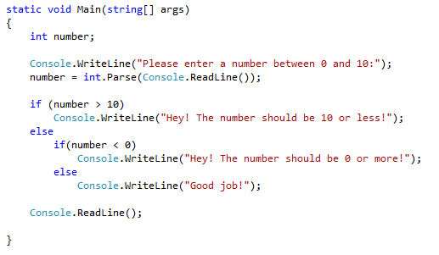
Example
In this example the { and } characters are not used in the if-statement. The rule is that if a block only contains a single line of code, the block characters are not required.

Slide 26
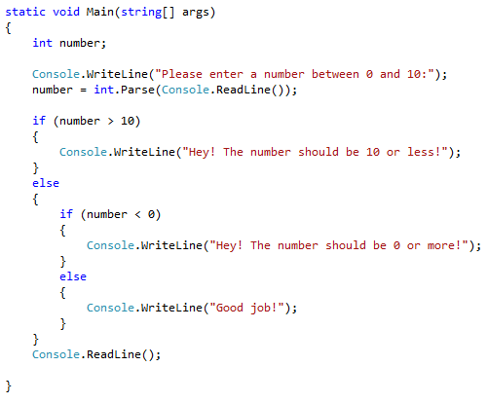
Example
However, it is recommended to use parenthesis with the if and else statements.
The previous example should be written like this:

Slide 27
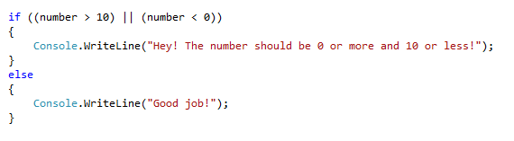
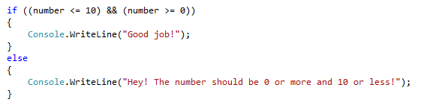
AND, OR
The conditional statements of the previous example can be combined by this way (|| is OR operator)
AND operator is &&. The previous example can be written also by this way:

Slide 28
AND, OR, Negation
The following statements checks if the variable a is less than -10 or bigger than 10
(a < -10 || a > 10)
The following statement tests if the variable a is between 2 and 4
(a > 2 && a < 4)
The following statement checks if the variable a is different than 5
(a != 5)

Slide 29
Exercises
Make a program, where you can test conditional statements with integer type variables a and b.
A) Is variable a bigger than 10
B) Is variable a less than variable b
C) 0 < a < 15
D) 0 < a, b < 15
E) Is variable a an even number
F) Is the product of a and b positive
G) Is a less than b, but less than 100 and b less than 50
Test the statements as follows:
bool result = (a > b); Console.WriteLine(”a > b : ” + result);
Try with different values of the variables a and b

Slide 30
Exercises (homework 26.9.2012)
Make a program which calculates the commission for the real estate agent.
The commission is 5% of the price of the house.
However, the commission is at least 2000€ and at most 15000€.

Slide 31
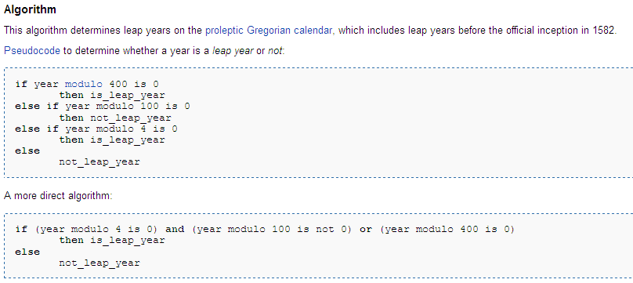
Exercises
Make a program, which checks is the given year a leap year
Every year whose number is divisible by four without a remainder is a leap year, excepting the full centuries, which, to be leap years, must be divisible by 400 without a remainder. If not so divisible they are common years. 1900, therefore, is not a leap year.
Use % operator

Slide 32
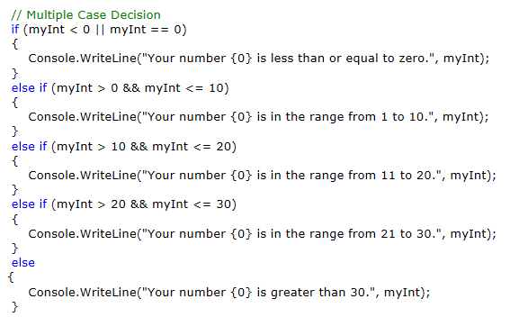
if – else if
When you have multiple expressions to evaluate, you can use the if/else if/else form of the if statement

Slide 33
Exercises
Make a program, which asks the total points of an examination from the student. The program gives grade for the user:
Points Grade 0 – 11 Failed (not accepted) 12 – 16 Satisfactory 17 – 21 Good 22 – 25 Excellent

Slide 34
Conditional statements switch - case

Slide 35
Switch statement
Study how the switch-case statement works
Read chapter The switch Statement from the page: http://www.csharp-station.com/Tutorials/Lesson03.aspx

Slide 36
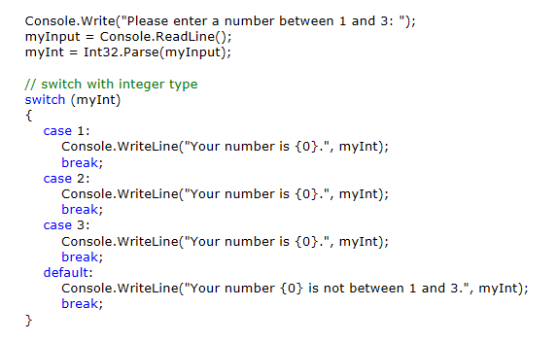
Switch - case

Slide 37
Exercises
The program asks first from the user the language (germany, finnish or english). The language is read to a variable of string type. The program says ”hello” to the user with the given langage. Use switch statement.
Make a program which asks the number of the month from the user (for example February’s number is 2). The program tells how many days are in the given month. Use switch statement.

Slide 38
Exercises
Make a program called calculator. The program can add, subtract, multiply and divide two given numbers
The program asks first the two numbers from the user
Then the program asks the operation (+,-,*,/) to be performed to these numbers
The program performs the calculation (either +,-,* or /) and outputs the result to the user.
http://www.csharp-station.com/Tutorials/Lesson02.aspx (binary operators)

Slide 39
Control Statements Loops
while
do-while
for

Slide 40
Loops
One of the most important technique when writing software is looping - the ability to repeat a block of code X times
In C# there are four different variants of loops
while
do-while
for
foreach
Links:
http://www.csharp-station.com/Tutorials/Lesson04.aspx
http://csharp.net-tutorials.com/basics/loops/

Slide 41
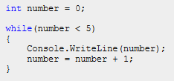
While loop
The while loop executes a block of code as long as the condition you give is true
The following code writes the numbers from 0 to 4

Slide 42
While loop
The boolean expression (condition) is evaluated before any code in the following block has executed.
When the boolean expression evaluates to true, the repeatable statements will execute.
Once the statements have executed, control returns to the beginning of the while loop to check the boolean expression again.
When the boolean expression evaluates to false, the while loop statements are skipped and execution begins after the closing brace of that block of code (StatementX).
Condition
true
Statement(s) to repeat
false
StatementX

Slide 43
While loop
In the while loop the condition expression is executed first
while (condition) statement
Often there are several statements to repeat
while (condition) { statement1; statement2; } statementX
Condition
true
Statement(s) to repeat
false
StatementX

Slide 44
Incrementing a number
The following code writes the numbers from 0 to 4
The statement number = number + 1 adds 1 to the previous value of the variable number.
The following statetements do the same thing
number += 1;
number++;

Slide 45
Increment and decrement operators
x++
++x
x--
--x
Try the following
int x = 5;
int y = x++;
And
int x = 5;
Int y = ++x;

Slide 46
Assignment operators
Expression
i = i + 2 adds 2 to the previous value of the variable i
This expression can be written also in the compressed form: i += 2
The operator += is called an assignment operator

Slide 47
Assignment operators
Most binary operators (+,-,*,/…) have a corresponding assignment operator
Examples
x = x * (y + 1) is equal to x *= y + 1
a = a – 10 is equal to a -= 10

Slide 48
Exercise
Make the previous example by yourself (a program which outputs the numbers from 0 to 4)
Study the program in more detail. Try the following
Run the program with debugger (set breakpoint, go, step)
Replace the statement number = number + 1 by the statement number++
Modify the program so that it outputs the numbers from 1 to 5
Take away the statement that increments the variable number
What happens?

Slide 49
Exercise
Modify the previous program so that it outputs all the even numbers from 0 to 20
while (??) { if (??) // is even number? { // output it } // increment counter by one }

Slide 50
Exercise
Make a program which calculates the sum and average of the numbers from 1 to 200
int i = 1 int sum = 0; while (i <= 200) { sum = sum + i; i++; // increment i by one (same as i=i+1) } // output the sum // calculate the average and output it

Slide 51
Exercises
11. Make a program, which outputs the multiplication table of a given number until 10:
Example:
1 * 6 = 6 2 * 6 = 12 : 10 * 6 = 60

Slide 52
Exercises (homework 3.10.2012)
10. Make a program which makes a conversion table from centimeters to inches (0 cm – 100 cm).
double cm = 1; while (cm <= 100) { double inches = ?; // output cm and inches // increment cm (cm = cm + 1 or cm += 1) }
Modify the program so that the step is 10 cm

Slide 53
Exercises (homework 3.10.2012)
Make a program which outputs all the leap years between a given period
Start and stop years are asked from the user
For example between year 300 and 2000

Slide 54
Exercises
Make a program, which asks numbers from the user until the user gives a negative number.
The program calculates the average of the numbers

Slide 55
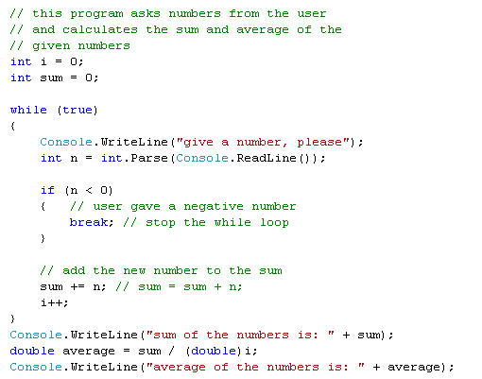
How to calculate the sum and average of the given numbers

Slide 56
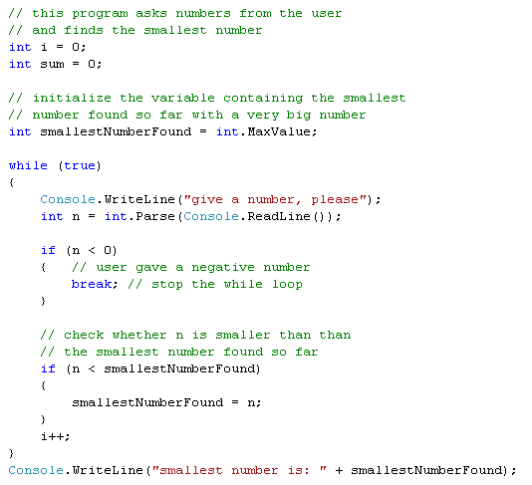
How to find the smallest number

Slide 57
Exercises
Make a program, which asks numbers from the user until the user gives a negative number.
The program outputs the biggest number given by the user

Slide 58
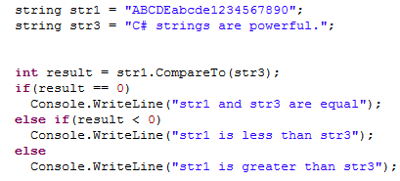
How to compare two strings
When you compare strings, you are producing a result that says one string is greater than or less than the other, or that the two strings are equal.
Two strings (str1 and str2) can be compared with CompareTo() method
It is used as follows: int result = str1.CompareTo(str2)
If str1 is before str2 in the alphabetical order, the result negative
If str1 is after str2 in the alphabetical order, the result positive
If str1 and str2 are equal, the result is zero

Slide 59
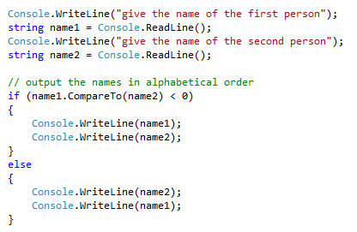
How to compare two strings
The following program asks two names from the user and outputs them in alphabetical order

Slide 60
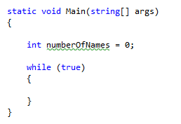
Exercise
Make a program which asks names from the user until the user gives an empty string
The program finds the first and the last name alphabetical order
Step-by-step instructions:
1. Make first the while loop

Slide 61
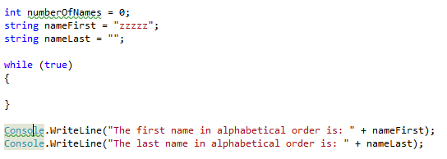
Exercise - instructions
2. Introduce two variables for the first and the last names (in alphabetical order)
3. Output the first and the last names at the end of the program
4. Compile the program and correct the possible errors (red). You don’t need to care about the warnings (green) yet
2.
3.

Slide 62
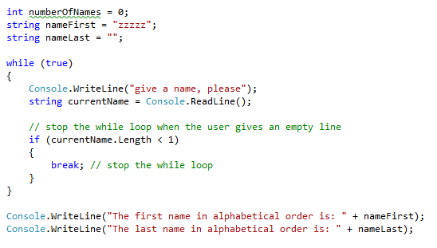
Exercise - instructions
5. Read the user input inside the while loop. Store the user input to a variable named currentName
6. Check if the user wants to stop (by giving an empty string). While loop is stopped by break statement
5.
6.

Slide 63
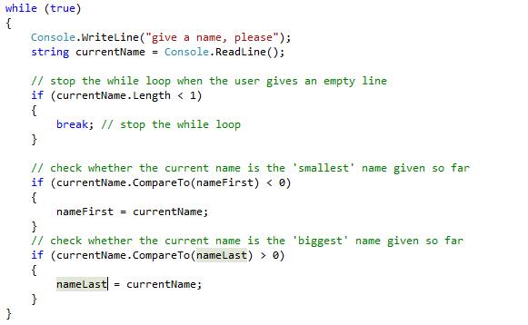
Exercise - instructions
7. Compare the current name to the ’smallest’ and ’biggest’ names given so far
7.
7.

Slide 64
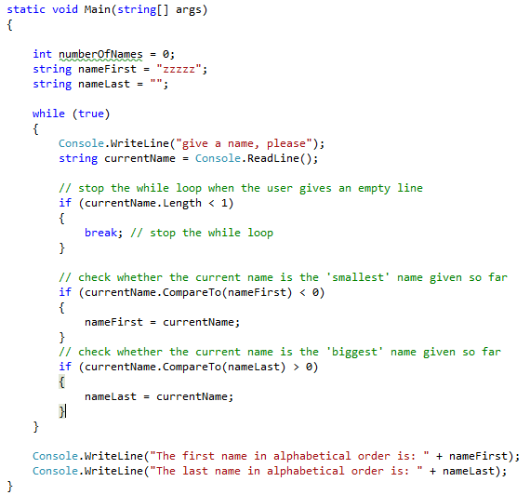
Exercise - instructions
8. The program is now complete. Compile and try it.
The complete program is shown here

Slide 65
Exercises
Modify the previous exercise so that it outputs:
Number of the given names
Increment the variable numberOfNames
Average length of the given names
currentName.Length

Slide 66
Random numbers

Slide 67
Random numbers
The class Random provides functionality to generate random numbers.
Links:
http://www.c-sharpcorner.com/UploadFile/mahesh/RandomNumber11232005010428AM/RandomNumber.aspx
http://www.geekpedia.com/tutorial238_Generate-Random-Numbers-using-Csharp.html

Slide 68
Random numbers
The following code returns a random number: int num = random.Next();
The following code returns a random number less than 1000. int num = random.Next(1000);
The following code returns a random number between min and max: random.Next(min, max);

Slide 69
Random numbers
Example: The following code generates 10 random numbers between 0 and 9
Random rnd = new Random(); // initialize the random number generator int i = 0; while (i < 10) { // generate and output random numbers Console.WriteLine(rnd.Next(10)); i++; }

Slide 70

Exercise
Make a program which simulates dice-playing (the program generates random numbers between 1 and 6).
Ask from the user how many times the dice is thrown (e.g. 100, 1000 or 100000)
Calculate the number of ones, twos, threes, fours, fives and sixs thrown.
Calculate the distribution of the dice playing results (the percentage of ones, twos etc.)

Slide 71
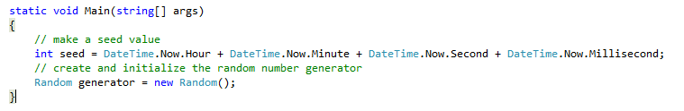
Exercise - instructions
1. Make a seed value and create a random number generator

Slide 72
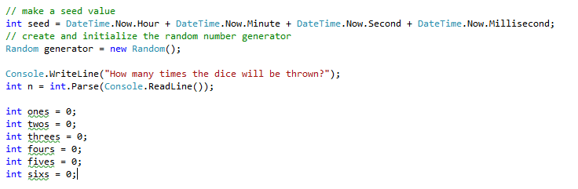
Exercise - instructions
2. Ask from the user how many times the dice will be thrown
3. Introduce int variables for each possible result (you can use also an array if you can)
2.
3.

Slide 73
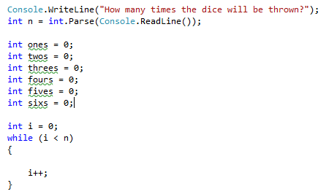
Exercise - instructions
4. Create a while loop which will be repeated as many time as the user wanted
4.

Slide 74
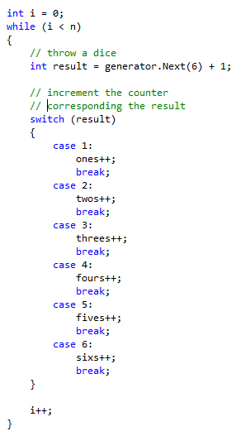
Exercise - instructions
5. Throw a dice. In other words, create a random number between 1 and 6.
6. Increment the counter which corresponds the result.
5.
6.

Slide 75
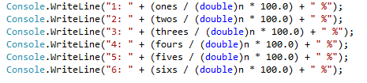
Exercise - instructions
7. Output the distribution of the results. In other words, calculate the percentage of ones, twos etc. Add this code after the while loop.
Note the type cast to double in the division. Without the cast the division will be made by integers and the decimals will be omitted.
8. Run the program and try with different input values (e.g. 10, 100, 1000000)
7.

Slide 76
For loop

Slide 77
For - loop
In C# there are four different variants of loops
while
do-while
for
foreach
This time we will study the for loop
Links
http://www.csharp-station.com/Tutorials/Lesson04.aspx
http://csharp.net-tutorials.com/basics/loops/

Slide 78
For loop
The for loop is preferred when you know how many iterations you want
because you know the exact amount of iterations, or
because you have a variable containing the amount
The for loop has the following syntax:
for( initialization; termination; increment) { statement(s) to repeat; }

Slide 79
For loop
for( initialization; termination; increment) { statement(s) to repeat; }
intialization
increment(i++)
true
Termination
(Condition)
Statement(s)
to repeat
Example:
for( int i = 0; i < 5; i++) { Console.WriteLine(i); }
false
StatementX

Slide 80
For loop initialization
for( initialization; termination; increment) { statement(s) to repeat; }
The initializer list is a comma separated list of expressions.
These expressions are evaluated only once during the lifetime of the for loop.
This is a one-time operation, before loop execution.
This section is commonly used to initialize an integer to be used as a counter.

Slide 81
For loop termination (condition)
for( initialization; termination; increment) { statement(s) to repeat; }
Once the initializer list has been evaluated, the for loop gives control to its second section, the boolean expression.
There is only one boolean expression, but it can be as complicated as you like as long as the result evaluates to true or false.
The boolean expression is commonly used to verify the status of a counter variable.

Slide 82
For loop
for( initialization; termination; increment) { statement(s) to repeat; }
When the boolean expression evaluates to true, the statements within the curly braces of the for loop are executed
After executing for loop statements, control moves to the top of loop and executes the iterator list, which is normally used to increment or decrement a counter

Slide 83
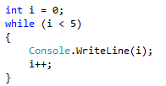

For and while loops compared
The following while and for loops provide an identical result

Slide 84
Exercises
11. Make a program, which outputs the multiplication table of a given number until 10:
Use for loop
Example:
1 * 6 = 6 2 * 6 = 12 : 10 * 6 = 60

Slide 85
Exercise
Make a program which makes a conversion table from centimeters to inches (1 cm – 100 cm).
double cm = 1; while (cm <= 100) { double inches = ?; // output cm and inches // increment cm (cm = cm + 1 or cm += 1) }
Modify the program so that the step is 10 cm
Use for loop!
Y:\Makela_Petteri\TITE11\Basics of Programming\CentimetersAndInches

Slide 86
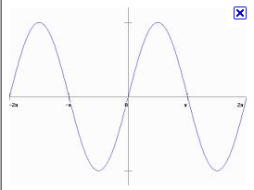
Exercise
Make a program, which calculates the value of the sine function between -10 and 10 with step 0.1

Slide 87
Exercise
Make a program, which calculates multiplication tables for the user. The program asks 10 questions from the user
The program shows the exercises (e.g. how much is 4 * 5?).
The user gives the answer to the exercise and the program tells to the user whether the calculation went right or wrong.
Finally the program tells to the user how many right and wrong answers the user got.
The numbers to the multiplication calculations are selected randomly (between 1-10).
Create the random number generator before the loop as follows: Random gen = new Random();
In the loop get the numbers as follows: int a = gen.Next(10)+1; int b = gen.Next(10)+1

Slide 88
Instructions
1. Create the random number generator
2. Make the two numbers A and B
int a = gen.Next(10)+1;
int b = gen.Next(10)+1;
3. Calculate what is the correct result A*B
Int result = a * b;
4. Show the equation to the user (e.g. “4*5=?”)
5. Read the users answer
6. Compare the users answer to the correct result
7. Tell the user was the answer right or wrong
8. Add a for loop so that the steps 2-7 are repeated 10 times

Slide 89
Exercise
Make a program which calculates the path travelled by the user through 10 points. The program asks the x and y coordinates from the user. The program calculates the total length of the path between these points.
double dist = Math.Sqrt(Math.Pow(x-x_previous, 2) + Math.Pow(y-y_previous, 2));
Advanced: Modify the program so that the x and y coordinates are read from a file
Study by yourself how to read files
Google: How do I read a text file C#
You need to use also the string.Split method

Slide 90
Files

Slide 91
Files
Link:
http://www.csharp-station.com/HowTo/ReadWriteTextFile.aspx
Text files provide a common denominator format where both people and programs can read and understand.
The .NET Framework includes convenience classes that make reading and writing text files very easy.
The following sequence outlines the basic steps necessary to work with text files:
1. Open the file
2. Read/Write to the file
3. Close the file

Slide 92
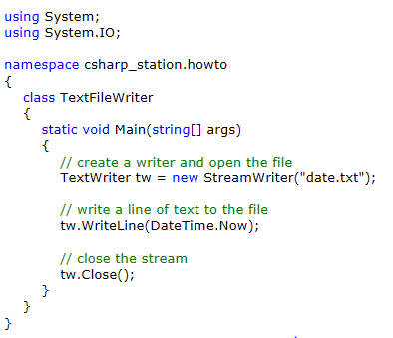
Writing a text file
The following program writes the current date to a file called ”date.txt”
You need to add ”using System.IO;” to the beginning of the program
The file is opened here (the name of the file to be created is ”date.txt”)
Current date and time (in text format) is written to the file here
The file is closed here

Slide 93
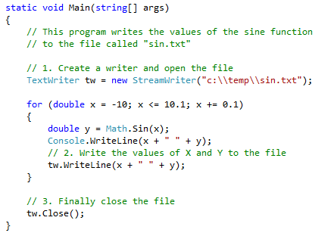
Writing a text file
The following example writes the values of the sine function to the file called ”sin.txt”

Slide 94
Exercise
Make a program which asks names from the user as long as the user gives an empty string. The program writes all the given names to a file called ”names.txt”
Intructions
Open the file first
Make a while loop
Inside the while loop ask the user to give the name
In case of empty string stop the loop by a break statement
Otherwise, write the name to the file
After the while loop close the file

Slide 95
Exercise(1/2)
Make a program which simulates (noisy) measurements of a sensor
The sensor produces a measurements which behave like a sine-like curve
Some noise is added to these measurements by a random number generator
Instructions
Create a program which generates the sine-curve in a loop. Calculate the measurement y = sin(x)
x is time and y is the measurement
Add some noise to the measurement using random number generator y += noise;
Output the time (x) and the measurement (y)
Write the result also to a file
Read the data to the Excel program and plot the result graphically

Slide 96
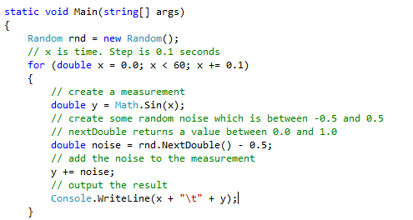
Exercise (2/2)
You can start from this kind of code
Modify the coefficients so that the result looks ’good’
Output the result to a file (use google)

Slide 97
Reading from a text file
There are several possibilities in C# to read text from a file
TextReader (http://www.csharp-station.com/HowTo/ReadWriteTextFile.aspx )
In this course we will use StreamReader class

Slide 98
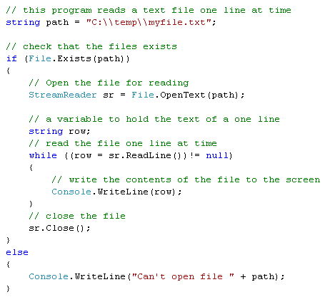
Example: Reading from a text file

Slide 99
Reading from a text file
Comments to the previous example
The path and file name were hard-coded. Obviously you can ask the file name from the user
The existence of the file can be checked with method File.Exists(path)
The file is opened with
StreamReader sr = new File.OpenText(path);
The file can be accessed now through variable ”sr”
The file is read line-by-line with method sr.ReadLine(). The text in that line is returned to a string type variable

Slide 100
Exercise 1
Make a program, which reads a file containing names (one name at one line). The program finds the first and the last names in alphabetic order
Text file example: names.txt in course folder

Slide 101
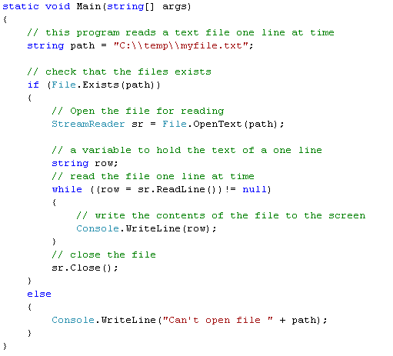
Exercise 1 - Instructions
Step 1: Make a program first, which just reads the file and outputs its contents to the console screen
Try to run the program!

Slide 102
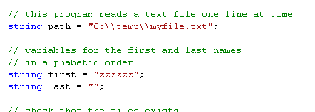
Exercise 1 - Instructions
Step 2: Introduce variables for the first and last names

Slide 103
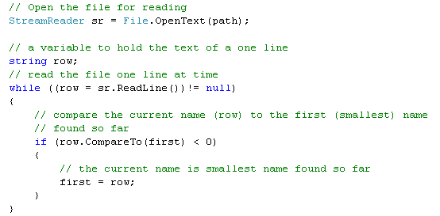
Exercise 1 - Instructions
Step 3: Write the while loop again
Inside the while loop we try to find the first name in alphabetic order

Slide 104
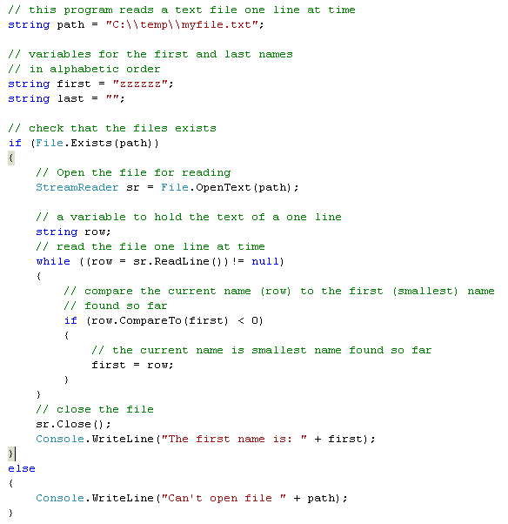
Exercise 1
Step 4: Write the first name to the screen.
The complete program is shown on right

Slide 105
Exercise 2
Make a program which reads numbers from a file. The program calculates the sum and the average of the numbers
There is one number per line in the file
The number in the row has to be converted to double type before it can be added to the sum
double x = double.Parse(row);

Slide 106
Arrays

Slide 107
Arrays
Links
http://msdn.microsoft.com/en-us/library/aa288453(VS.71).aspx
http://www.csharp-station.com/Tutorials/Lesson02.aspx
http://csharp.net-tutorials.com/basics/arrays/

Slide 108
Arrays
Sometimes we don’t know in advance how many variables are needed to handle the data.
Also in some cases we would need so many variables that it would need to much writing to name them all.
For example, there may be 50 participants in the course, whose names should be stored. It would be impractical to declare 50 string type variables.

Slide 109
Arrays
The following example would be impractical. Naming the variables and asking the names would require too much work. In addition, how to stop asking the names if there are just 50 participants?
string name1,name2,name3,...., name50;
// asking the names from the user
Console.Write(”Give a name please: ");
name1 = Console.ReadLine();
Console.Write(”Give a name please: ");
name2 = Console.ReadLine();
:
Console.Write(”Give a name please: ");
name3 = Console.ReadLine();
// in this phase we would handle the names somehow (e.g. sort)
// writing the names to the screen
Console.WriteLine(name1);
Console.WriteLine(name2);
:
Console.WriteLine(name50);

Slide 110
Arrays
The solution to the problem is a data structure called array.
An array is a data structure consisting of a collection of variables, each identified by an index.
An array is stored so that the position of each element can be computed from its index
C# arrays are zero indexed; that is, the array indexes start at zero.
The index of the last element is the size of the array minus one
Arrays in C# work similarly to how arrays work in most other popular languages.
There are, however, a few differences that you should be aware of.

Slide 111
Arrays
The following line of code creates an array called numbers, which can be used to store integer numbers
int[] numbers = new int[8];
The size of this array is 8. The index of the first element is 0 and the index of the last element is 7 (size-1)
7
1
8
8
12
3
Index:
0
1
2
3
4
5
6
7

Slide 112
Arrays
You can access the array elements by using the index:
int[] numbers = new int[8]; numbers[0] = 7; numbers[1] = 1; numbers[2] = numbers[0] + numbers[1];
7
1
8
8
12
3
Index:
0
1
2
3
4
5
6
7

Slide 113
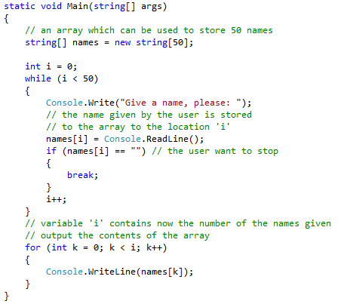
Arrays
The previous example can be made with much less writing by using arrays:

Slide 114
Declaring an array
Array of 5 integers can be declared as follows
int[] myArray = new int [5];
Note: In C# this declaration is not possible: int myArray[] = …;
Array of 6 strings can be declared similarly:
string[] myStringArray = new string[6];

Slide 115
Array initialization
It is possible to initialize the array upon declaration:
int[] myArray = new int[] {1, 3, 5, 7, 9};
string[] weekDays = new string[] {"Sun","Sat","Mon","Tue","Wed","Thu","Fri"};
Note that the rank specifier is not needed in this case
When you initialize an array upon declaration, it is possible to use the following shortcuts:
int[] myArray = {1, 3, 5, 7, 9};
string[] weekDays = {"Sun","Sat","Mon","Tue","Wed","Thu","Fri"};

Slide 116
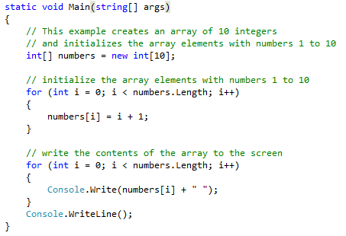
Example
The following example creates an array of 10 integers and initializes the array elements with numbers 1 to 10
The size of the array is obtained from the Length property of the array
int size = numbers.Length;

Slide 117
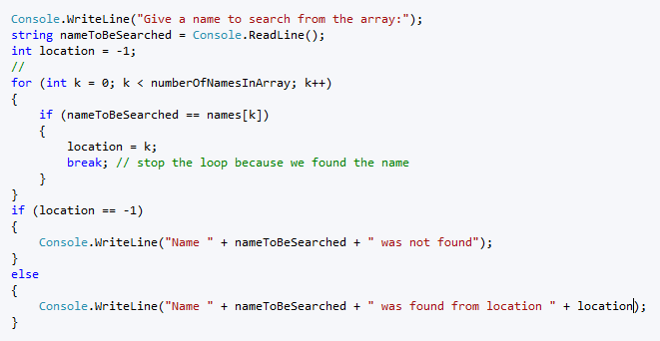
Example
The following program searches the first occurrence of a given name from the array

Slide 118
Sorting an array
To sort array of primitive types such as int, double or string use method Array.Sort(Array) with the array as a paramater.
// sort int array int[] intArray = new int[5] { 8, 10, 2, 6, 3 }; Array.Sort(intArray); // write array for (int i = 0; I < intArray.Length; i++)
Console.Write(i + " "); // output: 2 3 6 8 10
// sort string array string[] stringArray = new string[5] { "X", "B", "Z", "Y", "A" }; Array.Sort(stringArray);

Slide 119
Exercises 1 and 2
Make a program, which
Generates random 20 numbers between 0 and 50
Stores these numbers to an array
Sorts the numbers to an ascending order
Prints the numbers to the screen
Make a program, which
Asks 4 names from the user
Stores these numbers to an array
Sorts the names to an ascending order
Prints the names to the screen

Slide 120
Exercises 3
Make a program which simulates dice-playing (the program generates random numbers between 1 and 6).
Ask from the user how many times the dice is thrown (e.g. 100, 1000 or 100000)
Calculate the number of ones, twos, threes, fours, fives and sixs thrown. Use an array:
int[] distribution = new int[6];
Calculate the distribution of the dice playing results (the percentage of ones, twos etc.)

Slide 121
Exercises 4
Make a program which asks names from the user as long as the user gives an empty string
Create a string array of size 100 (at most 100 names can be asked)
The program will do the following
sorts the names in ascending order
outputs the first name in alphabetical order (the first name in the sorted array)
outputs the last name in alphabetical order (the last name in the sorted array)
The program program raffles one name from the name array
Take a random number between 0 and number of names minus one
Output the name having the corresponding index

Slide 122
Exercise 5
Make a program, which reads a file containing names (one name at one line). The program sorts all the names in to alphabetic order
Text file example: names.txt in course folder

Slide 123
Exercise 5 - Instructions
Step 1: make a program first, which just reads the file
Try to run the program!

Slide 124
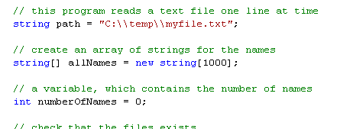
Exercise 5 - Instructions
Step 2: Add two variables:
A string array for the names
A variable, which contains the number of the names

Slide 125
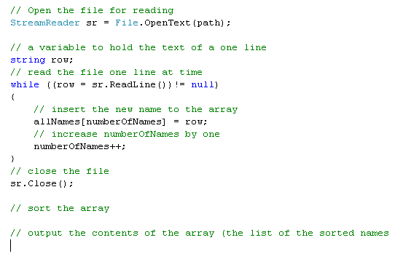
Exercise 5 - Instructions
Step 3: Write the while loop

Slide 126
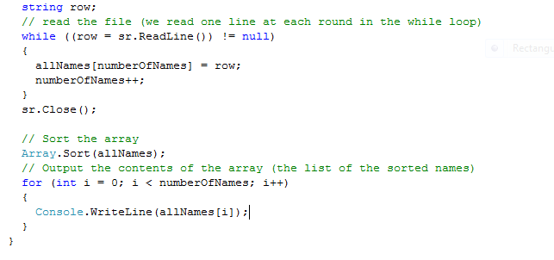
Exercise 5 - Instructions
Step 4: Write the rest of the program
The complete program is in folder “Reading files”

Slide 127
Exercise 6
Make a program, which reads numbers from the file.
The program has the following properties
The numbers are stored to an array
The numbers are sorted to an ascending order
The program outputs the smallest and largest number given
The program calculates the median of the numbers
What is median?
The program calculates sum and average of the numbers
The program calculates the variance and the standard deviation of the numbers

Slide 128
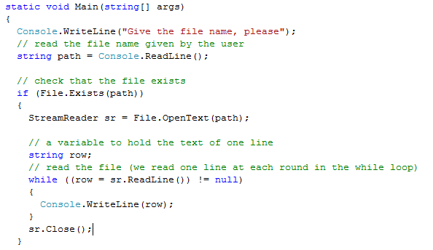
Exercise 6 - Instructions
Google: C# how to read text file line by line
Step 1:
Ask the file name (and path) from the user.
Read the file with the following program code
Try the program

Slide 129
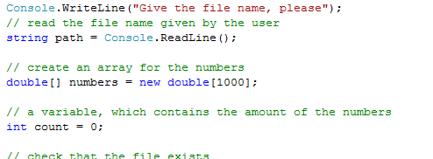
Exercise 6 - Instructions
Step 2: Add the variables:
Array for the numbers
A variable, which contains the number of the numbers

Slide 130
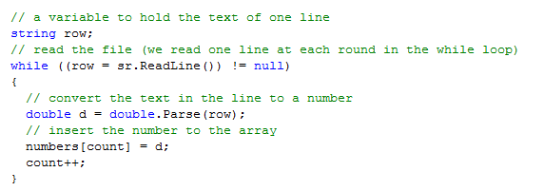
Exercise 6 - Instructions
Step 3: Modify the while loop
Convert the text in the line to a number
Insert the number to the array

Slide 131
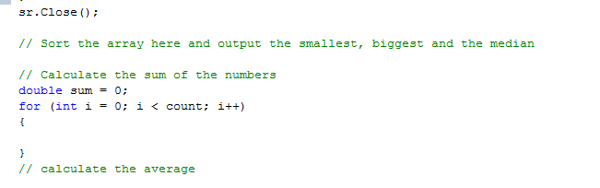
Exercise 6 - Instructions
Step 3:
Sort the array
Output the smallest (first) and the biggest (last) numbers
Output the median (the number in the middle of the array)
Calculate the sum of the numbers in a new for loop
Calculate the average
Try to calculate the standard deviation

Slide 132
Exercise 7 (Advanced)
Make a program, which reads a file containing waypoints obtained from GPS receiver.
Each row in the file contains one waypoint:
Name X-coordinate Y-coordinate
E.g. “PointA 100.0 245.0”
Make a program, which calculates length of the path going through all the waypoints
You don’t need an array
You must separate the name and the x and y-coordinates with Split method
string[] s = row.Split(); string name = s[0]; double x = double.Parse(s[1]); double y = double.Parse(s[2]);

Slide 133
Exercise 8 (Advanced)
Make a program which read GPS data from a file in NMEA format.
The program calculates the average of the altitude (height) of the receiver.
The NMEA data is on the next page of this slide show (copy it to a text file)
Altitude is somewhere in the $GPGGA message. Find the specification of NMEA from the internet
Read the file one line at time. Try to use row.Split to split the string to pieces. Comma (,) is used as a separator

Slide 134
Instructions
Make a first a program which reads the file one line at time
Output the line to the screen
Modify the program so that it will take only the lines starting with $GPGGA
string row;
string preamble = row.SubString(?, ?);
If (preamble.CompareTo(”$GPGGA”) == 0)
Split the row to pieces
string[] pieces = row.Split(’,’);

Slide 135
NMEA DATA example
$GPRMC,184332.07,A,1929.459,S,02410.381,E,74.00,16.78,210410,0.0,E,A*2B $GPGGA,184333.07,1929.439,S,02410.387,E,1,04,2.8,100.00,M,-33.9,M,,0000*65 $GPGLL,1929.420,S,02410.393,E,184334.07,A,A*71 $GPVTG,16.78,T,,M,74.00,N,137.05,K,A*36 $GPRMC,184336.07,A,1929.380,S,02410.405,E,74.00,16.78,210410,0.0,E,A*27 $GPGGA,184337.07,1929.361,S,02410.411,E,1,04,1.8,100.00,M,-33.9,M,,0000*60 $GPGLL,1929.341,S,02410.417,E,184338.07,A,A*76 $GPVTG,16.78,T,,M,74.00,N,137.05,K,A*36 $GPRMC,184340.07,A,1929.301,S,02410.429,E,74.00,16.78,210410,0.0,E,A*21 $GPGGA,184341.07,1929.282,S,02410.435,E,1,04,2.3,100.00,M,-33.9,M,,0000*63 $GPGLL,1929.262,S,02410.441,E,184342.07,A,A*78 $GPVTG,16.78,T,,M,74.00,N,137.05,K,A*36 $GPRMC,184344.07,A,1929.223,S,02410.452,E,74.00,16.78,210410,0.0,E,A*28 $GPGGA,184345.64,1929.203,S,02410.458,E,1,04,2.3,100.00,M,-33.9,M,,0000*60 $GPGLL,1929.183,S,02410.464,E,184346.07,A,A*77 $GPVTG,16.78,T,,M,74.00,N,137.05,K,A*36 $GPRMC,184348.07,A,1929.144,S,02410.476,E,74.00,16.78,210410,0.0,E,A*20 $GPGGA,184349.07,1929.124,S,02410.482,E,1,04,1.4,100.00,M,-33.9,M,,0000*6C $GPGLL,1929.104,S,02410.488,E,184350.07,A,A*7D $GPVTG,16.78,T,,M,74.00,N,137.05,K,A*36 $GPRMC,184352.07,A,1929.065,S,02410.500,E,74.00,16.78,210410,0.0,E,A*29 $GPGGA,184353.07,1929.045,S,02410.506,E,1,04,2.6,100.00,M,-33.9,M,,0000*6D $GPGLL,1929.026,S,02410.512,E,184354.07,A,A*7A $GPVTG,16.78,T,,M,74.00,N,137.05,K,A*36 $GPRMC,184356.07,A,1928.986,S,02410.524,E,74.00,16.78,210410,0.0,E,A*2E $GPGGA,184357.08,1928.967,S,02410.530,E,1,04,1.9,100.00,M,-33.9,M,,0000*67 $GPGLL,1928.947,S,02410.536,E,184358.08,A,A*70 $GPVTG,16.78,T,,M,74.00,N,137.05,K,A*36 $GPRMC,184400.08,A,1928.907,S,02410.547,E,74.00,16.78,210410,0.0,E,A*29 $GPGGA,184401.08,1928.888,S,02410.553,E,1,04,2.2,100.00,M,-33.9,M,,0000*6E $GPGLL,1928.868,S,02410.559,E,184402.08,A,A*7D $GPVTG,16.78,T,,M,74.00,N,137.05,K,A*36 $GPRMC,184404.08,A,1928.829,S,02410.571,E,74.00,16.78,210410,0.0,E,A*25 $GPGGA,184405.08,1928.809,S,02410.577,E,1,04,1.1,100.00,M,-33.9,M,,0000*65 $GPGLL,1928.789,S,02410.583,E,184406.08,A,A*7E $GPVTG,16.78,T,,M,74.00,N,137.05,K,A*36 $GPRMC,184408.08,A,1928.750,S,02410.595,E,74.00,16.78,210410,0.0,E,A*22 $GPGGA,184409.08,1928.730,S,02410.601,E,1,04,2.8,100.00,M,-33.9,M,,0000*64 $GPGLL,1928.710,S,02410.607,E,184410.08,A,A*76 $GPVTG,16.78,T,,M,74.00,N,137.05,K,A*36 $GPRMC,184412.08,A,1928.671,S,02410.619,E,74.00,16.78,210410,0.0,E,A*2C $GPGGA,184413.08,1928.651,S,02410.625,E,1,04,2.3,100.00,M,-33.9,M,,0000*64 $GPGLL,1928.632,S,02410.630,E,184414.08,A,A*77 $GPVTG,16.78,T,,M,74.00,N,137.05,K,A*36 $GPRMC,184416.08,A,1928.592,S,02410.642,E,74.00,16.78,210410,0.0,E,A*28 $GPGGA,184417.08,1928.573,S,02410.648,E,1,04,2.1,100.00,M,-33.9,M,,0000*6A $GPGLL,1928.553,S,02410.654,E,184418.08,A,A*7D $GPVTG,16.78,T,,M,74.00,N,137.05,K,A*36 $GPRMC,184420.08,A,1928.513,S,02410.666,E,74.00,16.78,210410,0.0,E,A*22 $GPGGA,184421.08,1928.494,S,02410.672,E,1,04,2.2,100.00,M,-33.9,M,,0000*6D $GPGLL,1928.474,S,02410.678,E,184422.08,A,A*7E $GPVTG,16.78,T,,M,74.00,N,137.05,K,A*36 $GPRMC,184424.08,A,1928.435,S,02410.690,E,74.00,16.78,210410,0.0,E,A*2A $GPGGA,184425.08,1928.415,S,02410.696,E,1,04,2.2,100.00,M,-33.9,M,,0000*6A $GPGLL,1928.395,S,02410.702,E,184426.08,A,A*7E $GPVTG,16.78,T,,M,74.00,N,137.05,K,A*36 $GPRMC,184428.08,A,1928.356,S,02410.714,E,74.00,16.78,210410,0.0,E,A*29 $GPGGA,184429.08,1928.336,S,02410.720,E,1,04,1.0,100.00,M,-33.9,M,,0000*6D $GPGLL,1928.316,S,02410.725,E,184430.08,A,A*77 $GPVTG,16.78,T,,M,74.00,N,137.05,K,A*36 $GPRMC,184432.08,A,1928.277,S,02410.737,E,74.00,16.78,210410,0.0,E,A*21 $GPGGA,184433.08,1928.257,S,02410.743,E,1,04,1.9,100.00,M,-33.9,M,,0000*6C $GPGLL,1928.238,S,02410.749,E,184434.08,A,A*74 $GPVTG,16.78,T,,M,74.00,N,137.05,K,A*36 $GPRMC,184436.08,A,1928.198,S,02410.761,E,74.00,16.78,210410,0.0,E,A*24 $GPGGA,184437.08,1928.178,S,02410.767,E,1,04,2.4,100.00,M,-33.9,M,,0000*6E $GPGLL,1928.159,S,02410.773,E,184438.08,A,A*75 $GPVTG,16.78,T,,M,74.00,N,137.05,K,A*36 $GPRMC,184440.08,A,1928.119,S,02410.785,E,74.00,16.78,210410,0.0,E,A*26 $GPGGA,184441.08,1928.100,S,02410.791,E,1,04,2.4,100.00,M,-33.9,M,,0000*69 $GPGLL,1928.080,S,02410.797,E,184442.08,A,A*77 $GPVTG,16.78,T,,M,74.00,N,137.05,K,A*36 $GPRMC,184444.08,A,1928.041,S,02410.809,E,74.00,16.78,210410,0.0,E,A*25 $GPGGA,184445.08,1928.021,S,02410.814,E,1,04,2.7,100.00,M,-33.9,M,,0000*6E $GPGLL,1928.001,S,02410.820,E,184446.08,A,A*79 $GPVTG,16.78,T,,M,74.00,N,137.05,K,A*36 $GPRMC,184448.08,A,1927.962,S,02410.832,E,74.00,16.78,210410,0.0,E,A*26 $GPGGA,184449.08,1927.942,S,02410.838,E,1,04,1.7,100.00,M,-33.9,M,,0000*6C $GPGLL,1927.922,S,02410.844,E,184450.08,A,A*7B $GPVTG,16.78,T,,M,74.00,N,137.05,K,A*36
Copy the data to the text file

Slide 136
$GPGGA,184333.07,1929.439,S,02410.387,E,1,04,2.8,100.00,M,-33.9,M,,0000*65

Slide 137
Methods

Slide 138
Links
http://www.c-sharpcorner.com/UploadFile/myoussef/CSharpMethodsP_111152005003025AM/CSharpMethodsP_1.aspx

Slide 139
Introduction to Functions (Methods)
A complex problem is often easier to solve by dividing it into several smaller parts.
Dividing the program code into separate methods makes the program code more modular and easier to understand
Building modularity to the program by utilizing the methods is called structural programming. (Another concept to improve the modularity further is called object oriented programming)

Slide 140
Advantages of methods
Methods make programs easier to understand
Methods can be called several times in the same program which make the program smaller and easier to maintain
New programs can be built by utilizing methods designed by other people instead of starting over from scratch
Methods hide details of operations from parts of the program that don’t need to know about them

Slide 141
methods
First the basic concepts of the methods are discussed
method definition
method call

Slide 142
method Definition
A method definition has the following syntax
static <type><method name>(<parameter list>)
{
<local variable declarations>
<sequence of statements>
}
Example
static int square(int number)
{
int sqr;
sqr = number * number;
return sqr;
}

Slide 143
method Definition
The method definition consists of two main parts: the method header and the method body
// method definition
static int square(int number)
{
int sqr;
sqr = number * number;
return sqr;
}
header
body
The header contains the return type, the method name and the parameter list (which can be empty)
The body contains the actual functionality (algorithm) of the method

Slide 144
method Call
The method call has the following syntax:
<method name>(<parameter list>)
For example, the square method can be called by following ways:
int result = square(5);
int value = 3; int result2 = square(value);
The result of the method call is a value of type <type>

Slide 145
Example:
Static int main()
{
// An example of method call
int value = 5;
int sqr= square(value);
// this is also a method call
Console.WriteLine("square of {0} is {1}\n", value, sqr);
}
// method definition
static int square(int number)
{
int sqr = number * number;
return sqr;
}

Slide 146
method Parameters
The first line of a method definition
int square(int number)
declares the parameter types and names and the type of the result that the method returns
The names used by square for its parameters are local to the square, and are not visible to any other method (other methods can use the same names without a conflict)
This also true of the variable sqr: the sqr in the method square is unrelated to the sqr in the method main

Slide 147
#include <stdio.h>
int main()
{
// An example of method call
int value = 5;
int sqr= square(value);
// this is also a method call
Console.WriteLine("square of {0} is {1}", value, result);
return 0;
}
// method definition
static int square(int number)
{
int sqr = number * number;
return sqr;
}
The variable used in the call of the method is called as an argument or an actual parameter
The variable in the parenthesized list of the method definition is called as a parameter or an formal parameter

Slide 148
method Type
The type of the return value defines the type of the method
The type of the method square is int
The return value of in the method header is int
static int square(int number)
{
int sqr;
sqr = number * number;
return sqr;
}
The type of the variable in return statement is int

Slide 149
method Type
A method may be defined to return any type of value. For example, method can return a value of type int, double, char, etc.
A method can also return an object

Slide 150
method Return Value
The value that the method square computes is returned to main by the return statement.
Any expression may follow return.
return expression;
The type of the expression has to correspond the type of the method type (taking into account the type conversion rules)
After the return statement the execution of the program code will return to the place where the method was called
The calling method can copy the returned value to a variable or it can ignore it.

Slide 151
method Returning no Value
A method does not need to return any value.
In this case void is used as a type specifier in method definition and declaration
The following method does not return any value
static void printChars(int numberOfChars, char c)
{
for (int i = 0; i < numberOfChars; i++)
{
Console.Write(c);
}
Console.WriteLine();
}
method type is void
There is no return statement (or the return statement is empty)

Slide 152
Return Type void
#include <stdio.h>
int main()
{
for (int i = 0; i < 5; i++)
{
printChars(10, '*');
}
return 0;
}
static void printChars(int numberOfChars, char c)
{
for (int i = 0; i < numberOfChars; i++)
{
Console.Write(c);
}
Console.WriteLine();
}
Program output:
**********
**********
**********
**********
**********

Slide 153
Exercises
methods

Slide 154
Exercise
A) Make a program which calculates the occurrences of characters ’a’ to ’z’ in one line given by the user
B) Make a program which calculates the occurrences of characters ’a’ to ’z’ in a file

Slide 155
Exercises
1. Make a method which takes one int-type value as parameter. The method multiplies that number with three and then returns the result.
2. Make a method, which tells the user whether the number given as a parameter is dividable by 7
3. Make a method Maximum(double a, double b). The method returns the smaller number of these two.
4. Make a method USDtoEUR(double usd). The method calculates how many euros is the given amount of US dollars.

Slide 156

Exercise 5
Write a method and for the following tasks. Try the methods by calling them in the main program
A) A method called abs_val that returns int and takes an int argument. It returns the absolute value of its argument, by negating it if it is negative
B) A method that calculates the distance between two points (2 dimensions)
C) A method that calculates the factorial of a given integer value (n)

Slide 157
Exercise 6
Write a program which converts Fahrenheit degrees to Celcius degrees and visa-versa
The program prints first the menu as follows
1 = Celsius to Fahrenheit
2 = Fahrenheit to Celcius
0 = Stop
If the user selects 1, method CtoF is called.
If the user selects 2, method FtoC is called
The degrees to be converted are asked from the user in CtoF and FtoC methods. Also the results are outputted in these methods
The conversion algorithms are as follows:
C = 5 * ( F – 32 ) / 9
F = C * 1.8 + 32
HOMEWORK!

Slide 158
Exercises
7. Make a method which checks whether the given year is a leap year. (in case of leap year the method returns true, otherwise false)
8. Make a method, which has two parameters: net price and VAT percent. The method calculates the total price and returns it. The main program asks the input from the user and outputs the total price.

Slide 159
Exercises
9. Make a method which returns the text corresponding the month number. Example 3 => March
10. Make a method, which checks whether the given date exists. The method takes three parameters: day, month and year. If the given date is valid the method returns true, otherwise false

Slide 160
Windows Forms
Graphical user interface

Slide 161
Advanced Excercises
Start to study Windows Forms programming by yourself by doing ”walkthroughs” in MSDN
Go to web page: ” Windows Forms Walkthroughs”
http://msdn.microsoft.com/en-us/library/zftbwa2b.aspx
Do the following walkthroughs:
Walkthrough: Creating a Simple Windows Form
Walkthrough: Getting Started with the Windows Forms Designer
Walkthrough: Creating a Resizable Windows Form for Data Entry

